Slide 1
CS 4350: Fundamentals of Software Engineering Lesson 4.1: Concurrent Programming Models
Jonathan Bell, Adeel Bhutta, Ferdinand Vesely, Mitch Wand
Khoury College of Computer Sciences
© 2022 Released under the CC BY-SA license

Slide 2
Learning Goals for this Lesson
At the end of this lesson, you should be able to:
Explain why almost all programs need to support concurrent actions
Understand how to write code that uses asynchronous results using async/await
Notes:
<read slide>

Slide 3
Masking Latency with Concurrency
Consider: a 1Ghz CPU executes an instruction every 1 ns
Utilize this “wasted” time by doing something else
Processing data
Communicating with remote hosts
Timers that countdown while our app is running
Waiting for users to provide input
CPU 1
Main Memory
150,000ns (just to read 4KB)
SSD
thread0()
CPU 1 Cache
7ns
100ns
10,000,000ns (just to seek!)
Magnetic HD
~100,000,000ns
Remote Computer (Internet in between)
3
Notes:
First principles: why do we need concurrency?
Mostly I/O. We are spoiled today with huge amounts of RAM, but there are still occasions when you need to read or write something to/from disk, or to/from network.
This diagram shows roughly the overhead of different kinds of I/O, in nanoseconds. Cutting-edge hardware architectures and OS designs aim to reduce these delays, but the rough order of magnitudes still stand.
If we are “computing” things (running instructions on the CPU), on a 1Ghz CPU, that’s nice and round, so you get 1 instruction executed per nano-second. You could run 150k instructions in time to read 4KB from SSD, 10m instructions in time to get the read head on your spinning magnetic HD into place to read something, or 100m instructions in time to receive a packet over internet.
So, it is desirable to be able to keep doing things while we are waiting for I/O, and not stop the world. Another way to put this, is that we would like to mask this latency to do such slow operations with concurrency: do something else while these I/O operations are happening.

Slide 4
Shared-Memory Multiprocessing
OS manages multiprocessing with multiple threads of execution
Takes advantage of multiple cores, multiple-issue architectures
Interprocess communication by shared memory
Threads may be interrupted at unpredictable times
Really, really hard to get right
Data races abound
Notes:
In many programming languages, like Java or C, you can have asynchronous computation with threads.
<Read slide, click to show the thread0 (build 1), thread1 (build 2), and sharing data (build 3)>
You might be familiar with this programming model. As it turns out, the “share data signal each other” part is extremely hard to get right, and almost impossible to prove correct
This is not how we get asynchronous computation in JS or TS

Slide 5
Alternative: Cooperative Multiprocessing
Each thread decides when it should yield to let other threads execute
Typically, when it starts an I/O operation.

Slide 6
Asynchronous Programming in JavaScript is an example of cooperative multitasking
All your code runs in a single thread
Primitive IO operations always yield
Data races are possible, but they take work to create.
Two primitive notions: events and listeners

Slide 7
What’s an “event”?
An event is something that happens in the world of the JS engine.
Examples:
A packet was received on port 6789
Listener 15 has completed
Timer 5 has expired
System call 3658 has returned with a value
Disk head 34 has reached track 5678

Slide 8
What’s a listener?
A _listener_ is a piece of code that is waiting to run.
Each listener is marked either with the event that it is listening for, or with notation "ready to run".
Listeners are often called “event handlers” or “promises” but we call them listeners because you already know the observer pattern, so you know what a listener is.

Slide 9
The JS engine maintains two data structures
The event queue, which is a list of events that have occurred but have not yet been handled.
The listener pool, which is a list of listeners that are waiting to run
Event Queue
Listener
Listener
Listener
event loop

Slide 10
Here’s a picture of your running job
Event Queue
Listener for response #1
Some other listener (currently running)
Listener for response #2
Listener for response #3
event loop
Event Being Processed:
Notes:
Here we see a picture of your running job. We imagine that you have just sent off 3 http requests. The JS runtime has called out to the OS to create 3 threads to this non-blocking I/O. In your thread (the only thread you can see!) you have an event queue (currently empty), and 3 listeners, each waiting for a response to one of the 3 requests. We also imagine that there is another listener that is currently running

Slide 11
The JS engine relies on the OS to do non-blocking IO
The OS will create a thread to do non-blocking IO, and your JS job will continue while the OS waits for the IO to finish
When the IO event concludes (say by receiving a packet), it puts an event on the JS event queue.

Slide 12
Here’s a picture of your running job
Event Queue
Listener for response #1
Some other listener (currently running)
Listener for response #2
Listener for response #3
event loop
OS thread
OS thread
OS thread
Event Being Processed:
Notes:
Here we see a picture of your running job. We imagine that you have just sent off 3 http requests. The JS runtime has called out to the OS to create 3 threads to this non-blocking I/O. In your thread (the only thread you can see!) you have an event queue (currently empty), and 3 listeners, each waiting for a response to one of the 3 requests. We also imagine that there is another listener that is currently running

Slide 13
Response #3 arrives
Event Queue
Response #3
Listener for response #1
Some other listener (currently running)
Listener for response #2
Listener for response #3
event loop
OS thread
OS thread
OS thread
Event Being Processed:
Notes:
Let’s imagine that while the other listener is running, response #3 comes in. Thread #3 receives the response and places an event on your event queue.

Slide 14
Response #1 arrives
Event Queue
Response #3
Response #1
Listener for response #1
Some other listener (currently running)
Listener for response #2
Listener for response #3
event loop
OS thread
OS thread
OS thread
Event Being Processed:
Notes:
Let’s further imagine that while the other listener is running, response #1 comes in. Thread #1 receives the response and places an event on the event queue.

Slide 15
Response #2 arrives
Event Queue
Response #3
Response #1
Response #2
Listener for response #1
Some other listener (currently running)
Listener for response #2
Listener for response #3
event loop
OS thread
OS thread
OS thread
Event Being Processed:
Notes:
Next, response #2 comes in, and its thread puts response #2 on the event queue

Slide 16
The current listener completes
Event Queue
Response #3
Response #1
Response #2
Listener for response #1
Some other listener (completed)
Listener for response #2
Listener for response #3
event loop
OS thread
OS thread
OS thread
Event Being Processed:
Notes:
Now, imagine that the current listener (the one that was running) completes its job. (Remember, we’re doing cooperative multitasking, so this should happen pretty soon!).

Slide 17
Now the event loop takes over
Event Queue
Response #3
Response #1
Response #2
Listener for response #1
Some other listener (completed)
Listener for response #2
Listener for response #3
event loop
OS thread
OS thread
OS thread
Event Being Processed:
Notes:
Now, imagine that the current listener (the one that was running) completes its job. (Remember, we’re doing cooperative multitasking, so this should happen pretty soon!).

Slide 18
The event loop handles events
Event Queue
Response #1
Response #2
Listener for response #1
Some other listener (completed)
Listener for response #2
Listener for response #3
Are there any listeners registered for this event?
If so, run the listener
After the listener is finished, repeat
OS thread
OS thread
OS thread
Response #3
Notes:
Now the event loop takes over. Here we’ve expanded the event loop to show what it does, and we’ve colored it white to show that it’s running. It asks:
Are there any listeners registered for this event?

Slide 19
The event loop handles events
Event Queue
Response #1
Response #2
Listener for response #1
Some other listener (completed)
Listener for response #2
Listener for response #3
Are there any listeners registered for this event?
If so, run the listener
After the listener is finished, repeat
OS thread
OS thread
OS thread
Notes:
Why, yes, there is a listener registered for this event, so we run it.

Slide 20
The event loop handles events
Event Queue
Response #2
Listener for response #1
Some other listener (completed)
Listener for response #2
Listener for response #3 (completed)
Are there any listeners registered for this event?
If so, run the listener
After the listener is finished, repeat
OS thread
OS thread
OS thread
Response #1
Notes:
When that listener completes, we return to the event loop, which takes another event off the queue and asks the same question. Again we have a listener for response #1, so we run it.

Slide 21
The event loop handles events
Event Queue
Response #2
Listener for response #1
Some other listener (completed)
Listener for response #2
Listener for response #3 (completed)
Are there any listeners registered for this event?
If so, run the listener
After the listener is finished, repeat
OS thread
OS thread
OS thread
Notes:
When that listener completes, we return to the event loop, which takes another event off the queue and asks the same question. Again we have a listener for response #1, so we run it.

Slide 22
The event loop handles events
Event Queue
Response #2
Listener for response #1 (completed)
Some other listener (completed)
Listener for response #2
Listener for response #3 (completed)
Are there any listeners registered for this event?
If so, run the listener
After the listener is finished, repeat
OS thread
OS thread
OS thread
Notes:
One more time… the listener for response #1 completes, and the event loop processes response #2. And so on: For each event, it simply asks: (build) are there any listeners waiting for this event? (build) of so, call it, (build) when finished, repeat
This may sound like a boring task, but it’s an important one, and the semantics of how it works are important to understand – otherwise we might end up confused, not understanding why our program gives some particular output, like the order of results printed a few slides ago

Slide 23
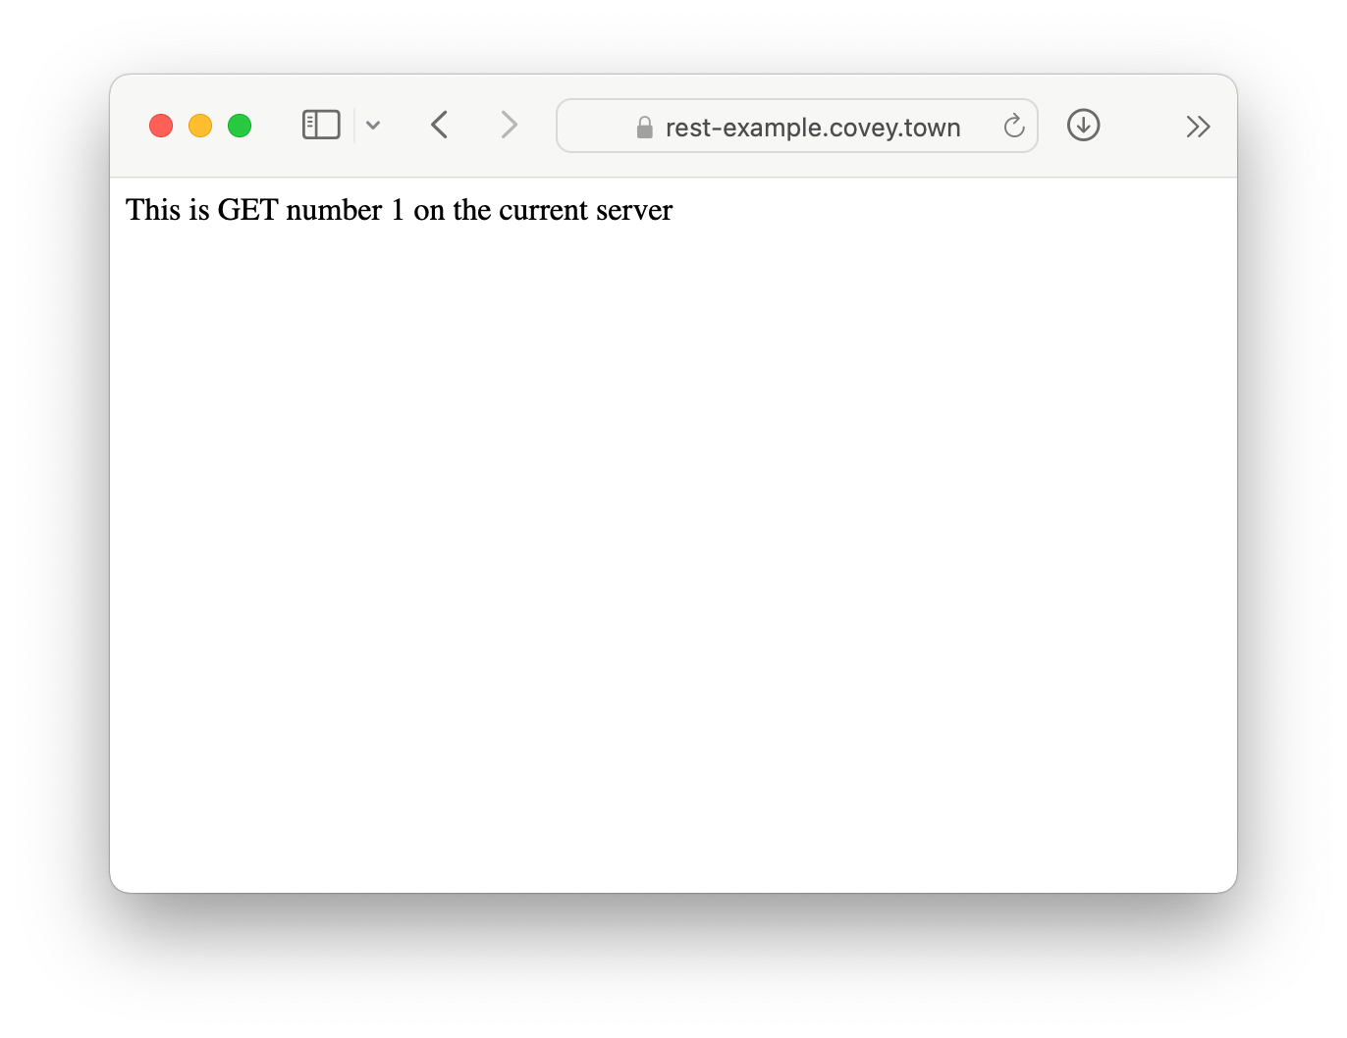
Running Asynchronous Example: HTTP Request
let nGets = 0; app.get('/', (req, res) => { nGets++; res.status(200).send(`This is GET number ${nGets} on the current server`); });
Notes:
We will take a look at how exactly asynchronous programming in JS works using the running example of making an request to a server.
Here we see the code in the server. (Explain code, key objective is to understand that it just sends back some text, and it will keep track of the order of requests (always returns GET number 1, 2, 3, …)
Our goal is to write some code for NodeJS that will send a request to the server and display the result on the console just like the browser shows here .

Slide 24
A Promise is a Representation of a Listener
The “Promise” lets us register a listener for something that will come in the future
To call a function that returns a Promise, you must ‘await’ it, from inside of an ‘async’ function
async function makeOneGetRequest(){ console.log('Making Request');
const response = await axios.get('https://rest-example.covey.town'); console.log('Heard back from server'); console.log(response.data); } makeOneGetRequest();
Output:
Making Request
Heard back from server
This is GET number 1 on the current server
Notes:
The easiest way to have asynchronous actions in JS is to use libraries that return something called a Promise.
A Promise is a representation of a listener, and lets us request some asynchronous action to happen (in the background), and then come back to this point and keep running once it’s available.
In this case, we will use a popular library for making HTTP requests, axios. The method “axios.get” calls through the NodeJS runtime to make an HTTP GET request to a URL.
This method returns a promise. (Click for build, explain that to call a method that returns a promise, we should await it, and do that from within an async function)
(Click for build to show output, note that it runs, hooray)
Explain that await will prevent code in this method after ‘await’ from running until the promise resolves with the data. This is to say: ‘await’ asks NodeJS to create a new listener which will continue running this method, once the return value from axios.get is available.
Detail: the “response” object contains lots of information about the response (how long it took, any headers that the server sent, etc). We just chare about the data, which is the message that we see in the browser when we navigate to this page, and what is shown in the ouptut

Slide 25
Awaiting a Promise Prevents Your Method from Continuing
Example: calling our makeOneGetRequest multiple times with await
async function makeThreeSerialRequests(): Promise<void> { await makeOneGetRequest(); await makeOneGetRequest(); await makeOneGetRequest(); } makeThreeSerialRequests();
Output:
Making Request
Heard back from server
This is GET number 2 on the current server
Making Request
Heard back from server
This is GET number 3 on the current server
Making Request
Heard back from server
This is GET number 4 on the current server
Notes:
“Await” will prevent the next line in an async function from running until the promise resolves. In this case, we can demonstrate that by calling our makeOneGetRequest function three times, awaiting on it each time. (click once to show build of output, comes line-by-line). Observe that the output shows up in the order that the requests were made.

Slide 26
The Event Loop Calls Listeners
JavaScript (and TypeScript) offer “event driven” concurrency: asynchronous tasks happen in the background, by the language runtime
Event loop is responsible for dispatching events when they occur
Main thread for event loop (buried somewhere in NodeJS) :
while(queue.waitForMessage()){
queue.processNextMessage();
}
The order of event processing is (in the general sense) unpredictable
Notes:
<read slide>

Slide 27
Event Handlers “Run To Completion”
AKA: Your code will not be “interrupted”
The listenerhandling an event and the functions that it (transitively) synchronously calls will keep executing until the function finishes.
The JS engine will not handle the next event until the listener finishes.
processing of event queue
f
g
listener1
h
...
i
listener2
...
j
Notes:
Did you notice as the event loop was working, it had a step “if so, call listener with event, after it’s done, repeat”. The “After it’s done” part is important because it means that our code won’t be interrupted unexpectedly (compare to a context switch in a multithreading application). This is called “Run to completion” semantics. <read slide>

Slide 28
Implications of Run-to-Completion
The good news: no interruptions/context switching
No other code will run until you finish (no worries about other threads overwriting your data)
processing of event queue
f
g
listener1
h
...
i
listener2
...
j
j will not execute until after i
Notes:
Again, the takeaway here is that even if handler1 calls a bunch of methods, no other handler will run until we’re done. In this example, j will not execute until after I
However, what is important to note here is that it might not be certain that listener1 will run before listener2. The order of which listener gets invokes first might be uknowable in some cases, and non-intuitive in others.

Slide 29
Listeners Complete when they Return or Await
Adding ‘async’ to our function definition makes it return a Promise!
async function makeOneGetRequest(): Promise<void> { console.log('1. Making Request'); const response = await axios.get('https://rest-example.covey.town'); console.log('2. Heard back from server'); console.log(response.data); } makeOneGetRequest(); console.log('3. All done!');
makeOneGetRequest returns the promise immediately upon hitting await!
Output:
1. Making Request
3. All done!
2. Heard back from server
This is GET number 5 on the current server
Notes:
As we’ll see in the next few lessons, despite this run-to-completion semantics, async programming can still be very confusing. What happens if we do NOT await an async function?
Remember how I had to add the “async” keyword to make the “await” work in this example? What this actually does, is, under the hood, make our function return a promise. I’ve shown the actual return type here to make that clear. We’ll see in the next lesson how exactly await works, and more about promises. However, the simple rule that we can have now is: “Listeners are completed when they reach their end and return, OR when they reach an await”.
Based on this rule, we can think hard about what the output should be here.
Which console.log do students think will be printed first, and which second? ‘Making Request” -> “Heard back”, “All Done” -> “Making Request”, or other? Hopefully now clear. (build)
This is our first look at seeing how we can write concurrent programs using the asynchronous program model: There was something that happened WHILE the data was being fetched from the server: the message ”all done” was printed! In the next lesson will dive deeper into concurrency.

Slide 30
Learning Goals for this Lesson
At the end of this lesson, you should be able to:
Explain why almost all programs need to support concurrent actions
Understand how to write code that uses asynchronous results using async/await
Notes:
<read slide>

